Slide 1
AI Agent for Digital Financial Literacy
CAPSTONE PROJECT
Presented By:
Student name : Shivansh Mudgal
College Name & Department : Dronacharya Group of Institutions & CSE(AIML)

Slide 2
OUTLINE
Problem Statement
Technology used
Wow factor
End users
Result
Conclusion
Git-hub Link
Future scope
IBM Certifications

Slide 3
Problem Statement
Many individuals struggle to understand and navigate essential financial tools and practices in the digital age.
There is a lack of accessible and reliable information on topics like UPI, online scams, interest rates, and personal finance.
This knowledge gap leads to financial insecurity, vulnerability to fraud, and a lack of confidence in digital finance.
Proposed Solution: The RAG-powered AI Agent helps users understand digital financial tools and practices by retrieving reliable information from government portals, banking websites, and educational platforms.

Slide 4
Technology used
IBM cloud lite services
Natural Language Processing (NLP)
Retrieval Augmented Generation (RAG)
IBM Granite model

Slide 5
IBM cloud services used
IBM Cloud Watsonx AI Studio
IBM Cloud Watsonx AI runtime
IBM Cloud Agent Lab
IBM Granite foundation model

Slide 6
Wow factors
Diverse Knowledge Base: Provides information on a range of topics, including:
Using UPI for payments.
Avoiding online scams and fraud.
Understanding interest rates and loan terms.
Personal finance management and budgeting.
Multilingual Support: Allows users to interact in their preferred language, ensuring accessibility for diverse backgrounds.
Culturally Inclusive: Delivers personalized and culturally relevant financial guidance.
Intuitive Q&A: Answers user questions directly, such as:
“How do I send money via UPI?”
“What is a safe interest rate for a loan?”

Slide 7
End users
Individuals from diverse backgrounds, including those new to digital banking, students, and professionals seeking to improve their financial knowledge.
Impact:
Empowerment: Equips users with essential knowledge.
Protection: Helps users protect themselves from fraud.
Confidence: Builds confidence in using digital financial services.
Accessibility: Makes financial literacy accessible, personalized, and culturally inclusive.

Slide 8
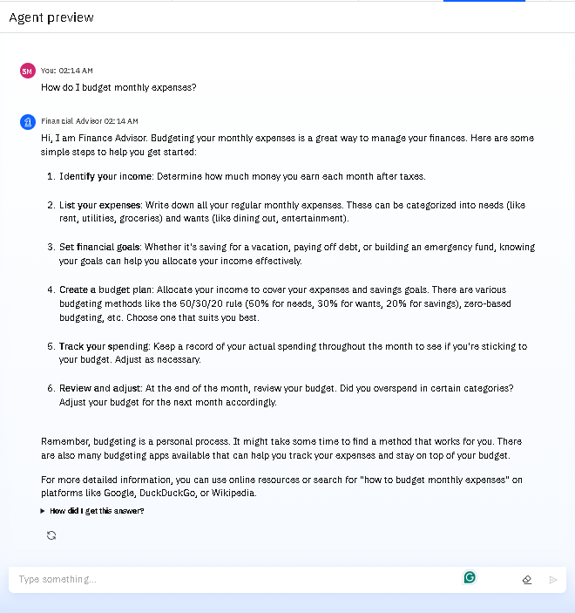
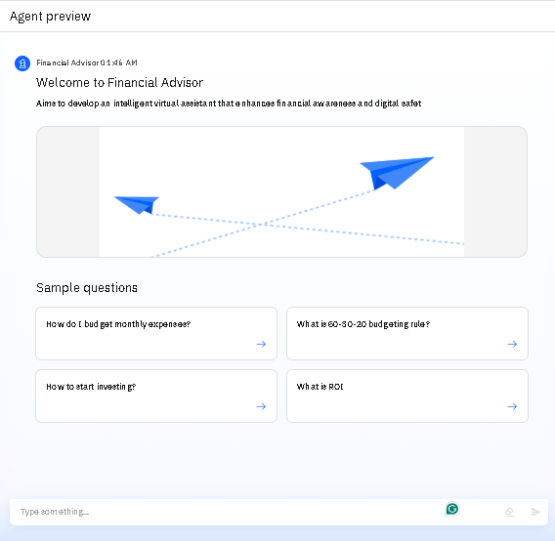
Results

Slide 9
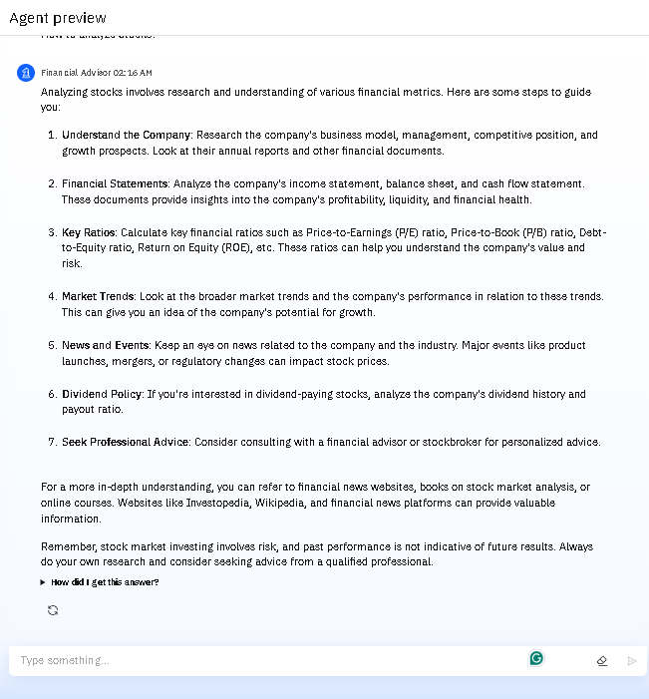
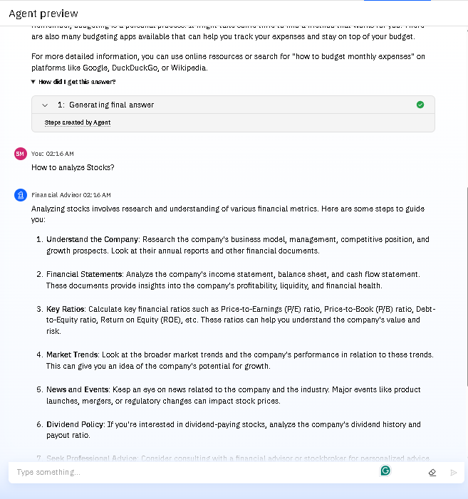
Results

Slide 10
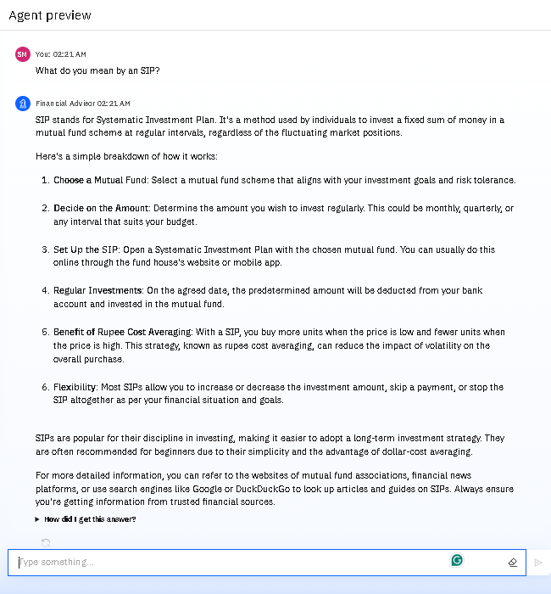
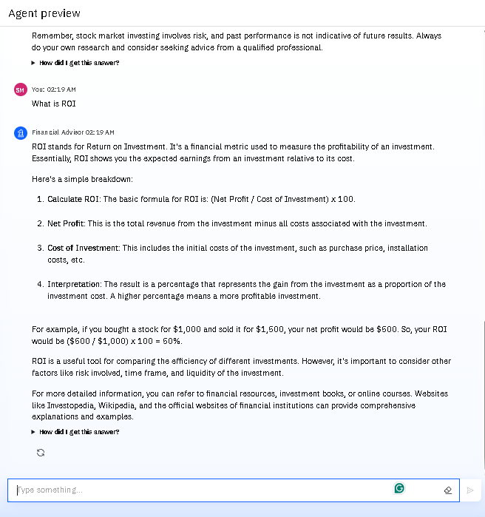
Results

Slide 11
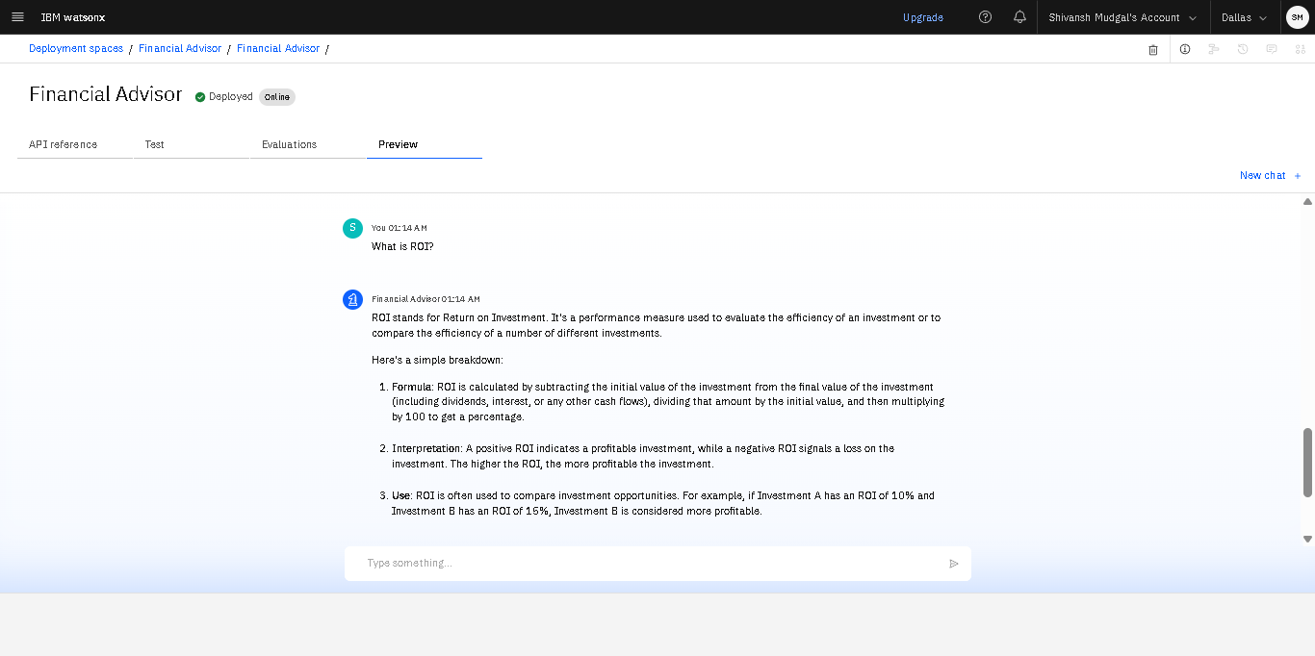
Results
Deployed AI Agent

Slide 12
Conclusion
Leverages RAG to bridge the financial knowledge gap.
Provides reliable, multilingual, and personalized information.
Empowers users with confidence.
Protects them from common pitfalls in the digital financial world.

Slide 13
Future scope
Integration with Financial Planning Tools: Connect with budgeting and investment apps for a seamless user experience.
AI-Assisted Financial Goal Setting: Help users set and track personal financial goals.
Interactive Simulations: Provide a safe environment for users to practice financial scenarios like investing or loan management.
Partnerships with Financial Institutions: Collaborate with banks and financial advisors to offer direct, expert guidance.

Slide 14
GitHub Link
Git hub link: https://github.com/shivanshmudgal/AI-Agent-for-Digital-Financial-Literacy

Slide 15
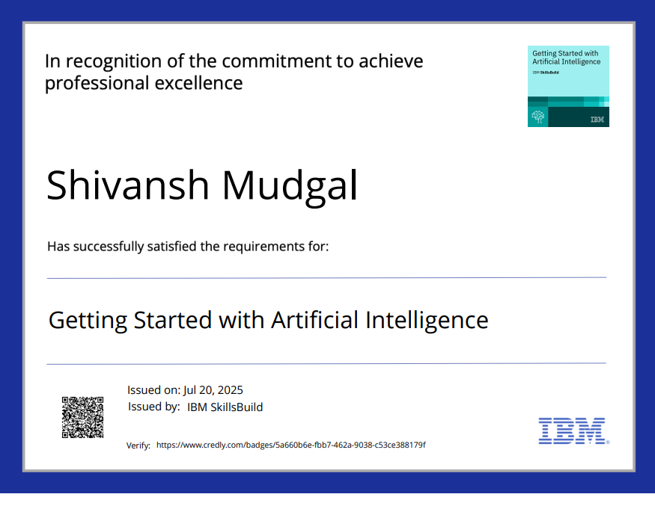
IBM Certifications

Slide 16
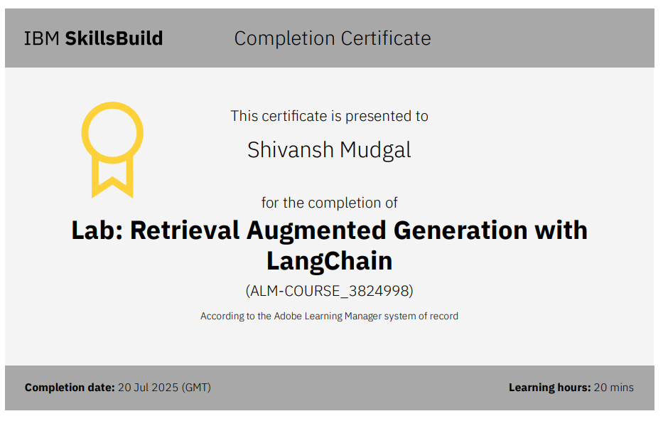

Slide 17
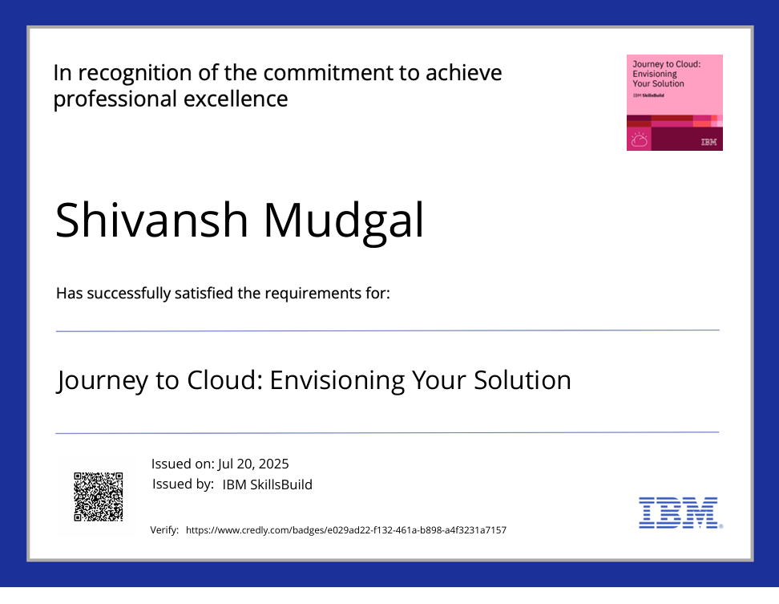

Slide 18
THANK YOU

